Slide 1
Distributed Data Processing for Large-Scale Simulations on Cloud
Ashik Adnan-22166003
Nazifa Khanom-22166009
Fahim Hasnat- 22166016
S M Mahsanul Islam Nirjhor-22166037

Slide 2
Introduction
Data pipeline is designed with careful considerations for the characteristics of the simulation data in order to achieve high parallel efficiency. The performance of the data pipeline is analyzed with two examples: 1) process electric potential obtained with a Poisson solver and 2) process thermal and fluid data obtained with a computational fluid dynamic solver
Focus is on data processing instead of data generation
The proposed data pipeline is designed in a general manner and is suitable for other types of data generators such as full wave electromagnetic and multiphysics solvers.

Slide 3
Advanced simulations enable the design and optimization with reduced prototyping cycles and costs; the predictive data analytics allow extracting meaningful knowledge of a design from both simulation and measurement data.
The computational challenges encountered in the large-scale simulations are accompanied by those from data-intensive computing. The large-scale simulations running on high performance computers are considered as a new type of data generation instrument beside experiments and sensors.

Slide 4
Many efforts have been taken to improve the computational efficiency of data intensive computing, to name a few: (1) minimizing the data movement across the memory hierarchy; (2) optimizing the communication strategy; (3) processing data in parallel; (4) developing high-speed and low-latency interconnects; and (5) co-designing the system components from hardware architecture to software
Applying the data-science approaches to handle large-scale simulation data for the hardware design community.

Slide 5
The data is obtained in parallel and labeled by the identifier of a process, or process ID. In addition, the simulation data contains the temporal and/or spectral information of physical quantities. The implementation of the data pipeline is based on Apache Beam and Zarr.
The performance of the proposed data pipeline is analyzed with two examples:1) process electric potential distribution obtained with a Poisson solver and 2) handles data obtained from a computational fluid dynamic (CFD) solver

Slide 6
The proposed pipeline is designed in a general manner and can be used to process data from other types of data generators such as full-wave electromagnetic and multiphysics simulations. The performance analyses consists of both storage and computational efficiency analysis. The scaling analyses demonstrate good parallel efficiency of the proposed data pipeline.

Slide 7
Simulation Data
The data in this work is acquired with a large-scale simulation running in parallel.
The data describes physical quantities or fields.
The simulation represents and emulates a physical system or process with computers
The simulation data is obtained in parallel on multiple processors.
The simulation data contains the temporal or spectral information of a physical system or a process, depending on whether the mathematical model is formulated in the time- or frequency-domain.

Slide 8
A Map-Reduce Operation over Simulation Data
They assume the simulation data are electric and magnetic fields, which are obtained with a 3D frequency-domain full-wave electromagnetic solver running in parallel on three processors.
The process ID is denoted by (c0, c1, c2).
A domain decomposition method is used by the simulation such that the obtained electric and magnetic fields on each process contains partial spatial
information.

Slide 9
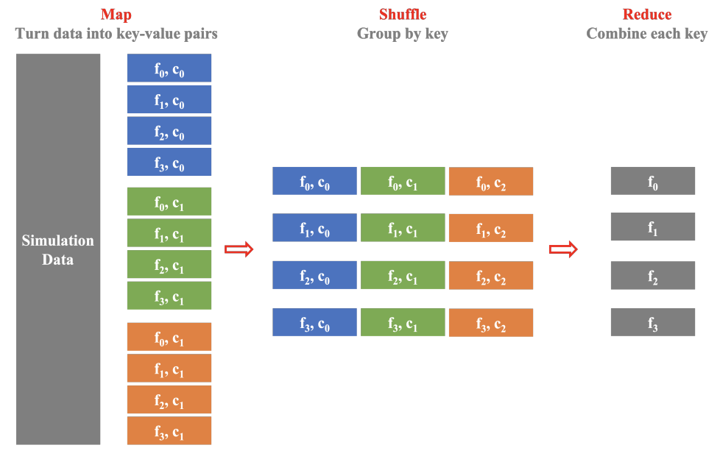
A Map-Reduce Operation over Simulation Data

Slide 10
Beam Driver Program and Runner
By using Beam, one can simply focus on the logical composition of the data processing task and bypass the low-level details of distributed computing.
The orchestration of distributed processing is fully managed by the runner.
To create a pipeline for distributed data processing, one needs to write a driver program with Beam SDKs.

Slide 11
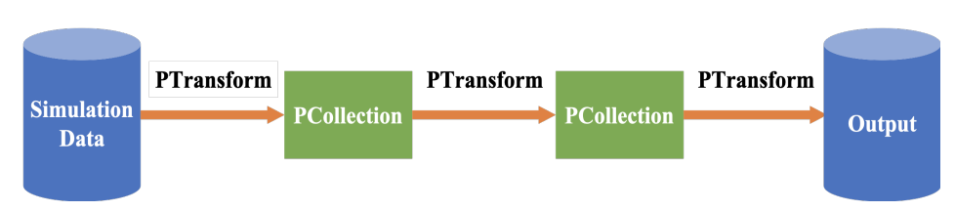
Beam Driver Program and Runner
The driver program contains the inputs, operations, outputs, and execution options for the pipeline runner.
Beam separates the programming layer from the runtime layer such that the driver program can be executed across various execution engines, or runners.
Beam capability matrix provides details on the capabilities of individual runners.

Slide 12
Parallel Output with Zarr
The storage format of the output tensor is Zarr: the physical representation of the output is a folder containing one metadata file and multiple chunk files and the chunk files are arranged by the fields (or components of a vector field) and coordinates from the simulation. The coordinates include the spatial, temporal, and spectral directions.

Slide 13
Reasons to use Zarr
Zarr allows multiple processes to concurrently write to the output tensor.
Zarr tensor can be read concurrently by multiple processes.
Zarr tensor can be stored on a file system.
Each data chunk is compressed before storage in Zarr format.

Slide 14
Performance Analysis
The performance of the proposed data pipeline has been analyzed with two examples:
Process Electric Potential Distribution
Process Thermal and Fluid Data

Slide 15
The simulation data represents the distribution of electric potential, which is obtained with a Poisson solver. The Poisson solver is based on the finite difference method and is implemented in TensorFlow. The Poisson solver runs in parallel on Tensor Processing Unit clusters.
The features of the obtained simulation data are:
The field: electric potential φ
TPU process IDs (c0, c1, c2)
The time step t

Slide 16
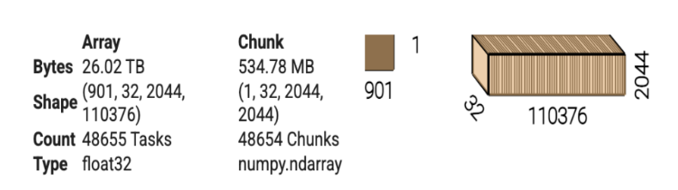
Storage Efficiency

Slide 17
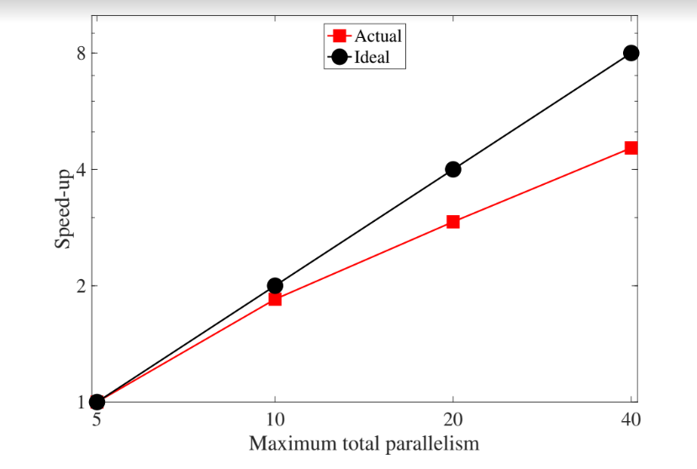
Strong scaling

Slide 18
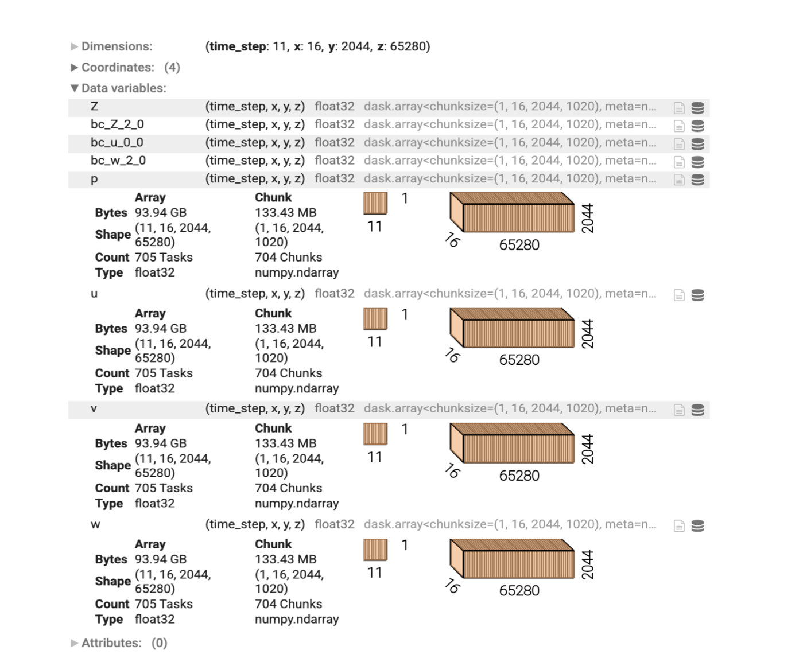
Process Thermal and Fluid Data
The simulation data is obtained from CFD solver.
The computation domain is a slab and the mesh size is 16×2044×65280 along x-, y-, and z-axis, respectively.
There are a total number of 64 subdomains and each has the mesh size of 16×2044×1020.

Slide 19
Storage Efficiency
The data pipeline converts five fields or field components obtained through the in-house CFD solver into Zarr format.
There are a total number of 704 data chunks associated with each Zarr tensor.
The original size of each data chunk is 133 MB, which is compressed into 526 KB with Zarr storage.
The original size of the simulation data in the test run is 470 GB, whereas in Zarr format, it is 1.8 GB.

Slide 20
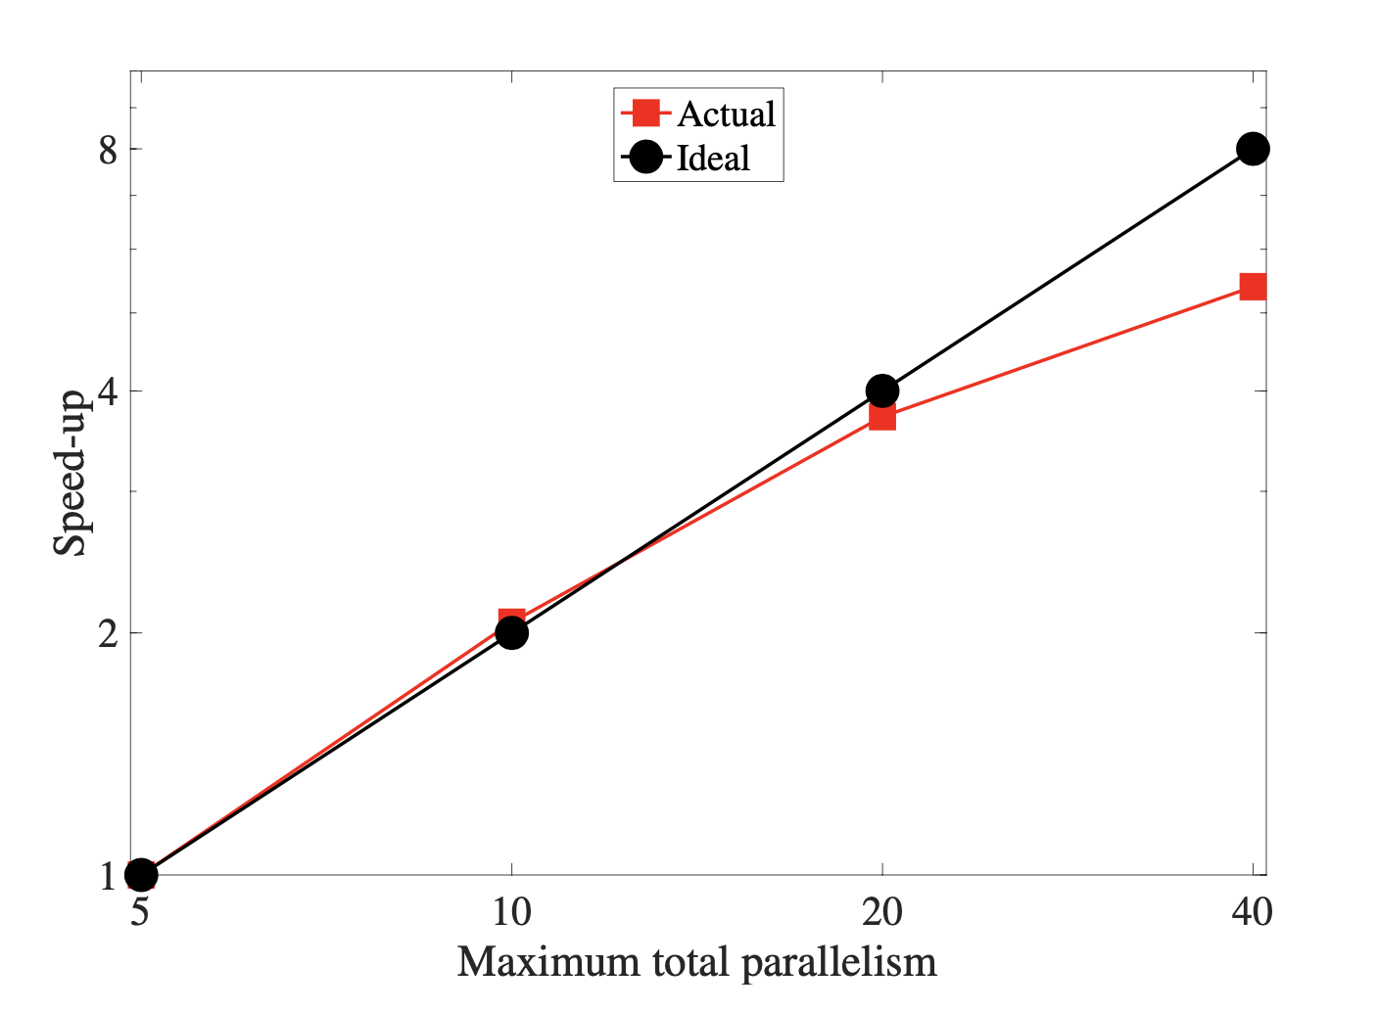
Strong Scaling
The amount of simulation data to be processed remain as 376 GB and the maximum total parallelism is proportionally increased.
The maximum total parallelism increases from 5 to 20, the strong scaling is approximately linear.
When the maximum total parallelism exceeds 40, the gain of the speed-up saturates.
It is because the workload is considered as small for the maximum total parallelism greater than 40.

Slide 21
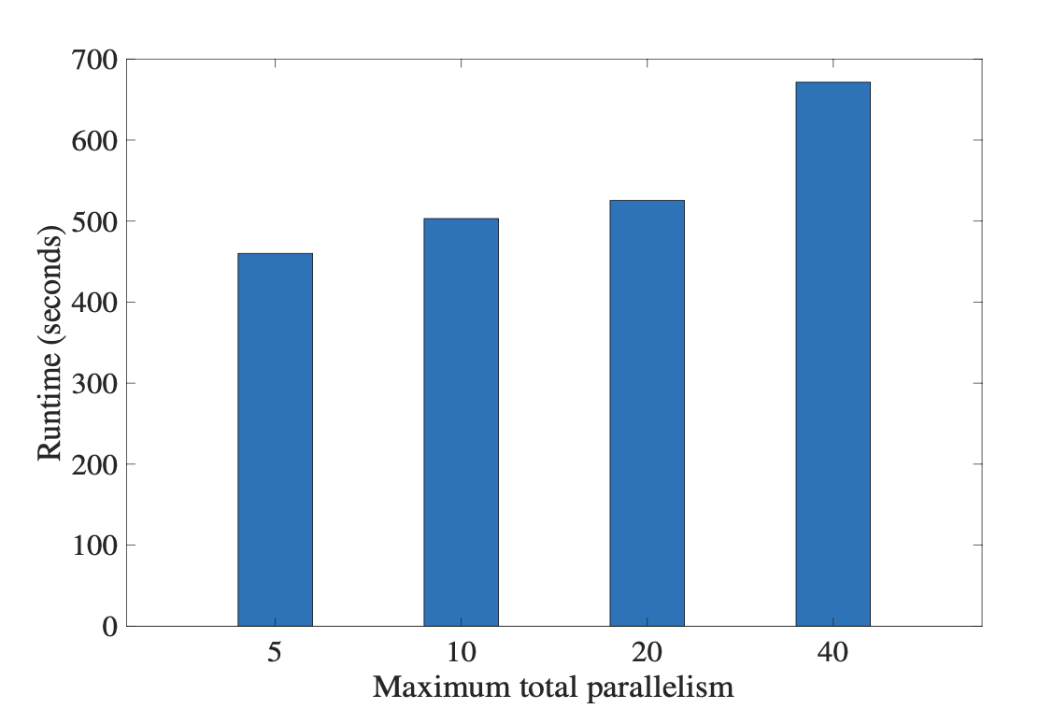
Weak Scaling
The ratio between the amount of simulation data to be processed and the maximum total parallelism is kept the same.
However, as the maximum total parallelism increases from 20 to 40, the runtime increases from 525.4 seconds to 671.5 seconds.
The increase of runtime is due to the increase of workload at the stages other than the map stage.

Slide 22
Conclusion
We propose a distributed data pipeline for large-scale simulations.
We designed the data pipeline by carefully considering the characteristics of simulation data.
The data pipeline is implemented with Beam and Zarr and can be executed on multiple environments offered by Cloud services.
The performance analysis demonstrates good storage and computational efficiency of the proposed data pipeline.

